Slide 1
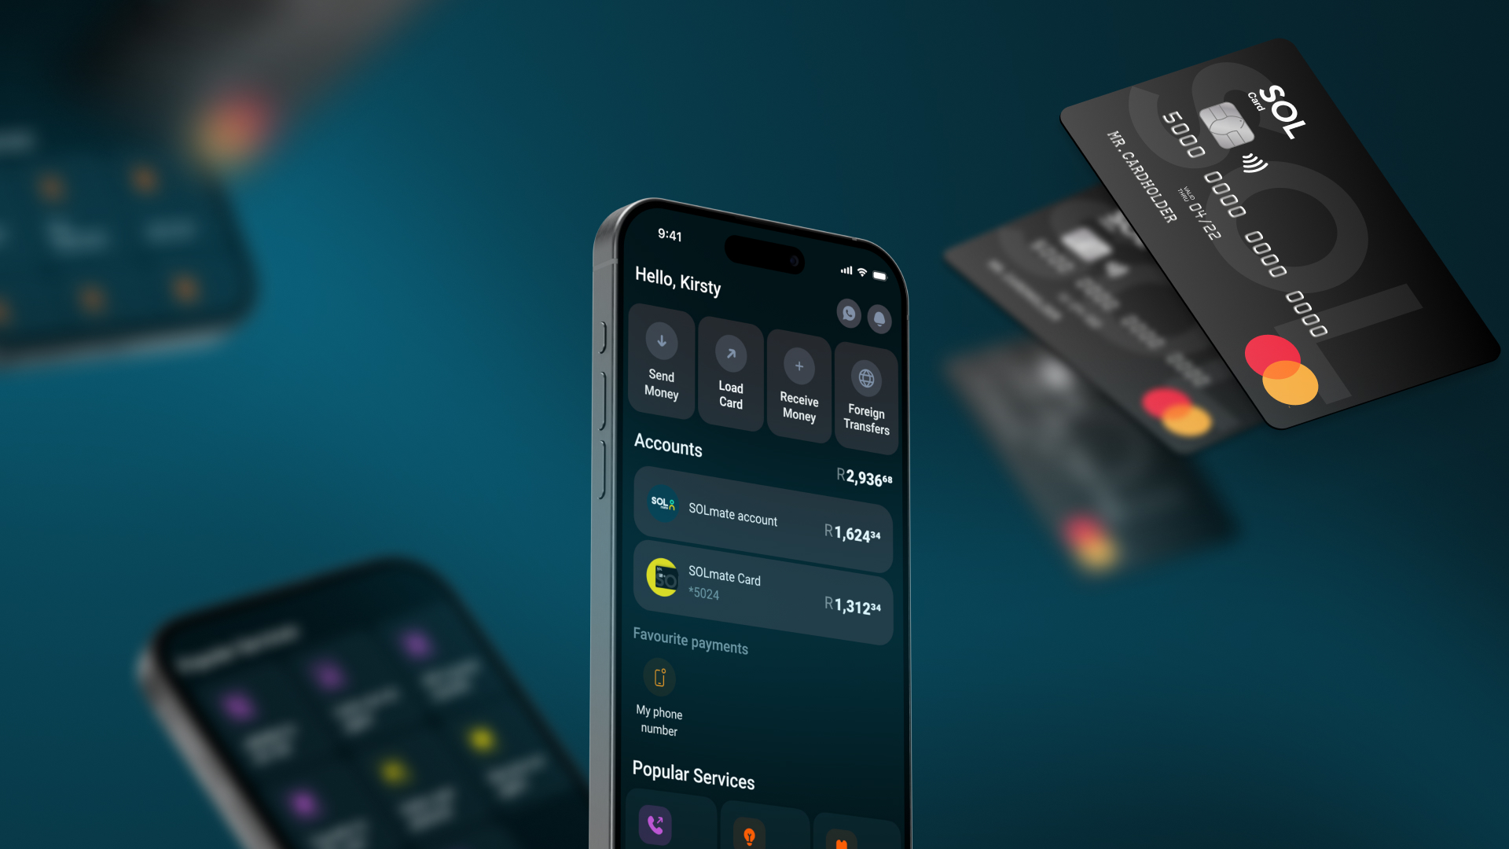

Financial
inclusion
in South Africa

Slide 2

What is
2/14
SOLmate is a mobile-first financial banking platform designed to provide affordable and accessible financial services to South Africa’s low-income population and empower financial inclusion.
www.solmate.co.za

Slide 3
SOL Ecosystem to build Financial services for Financial inclusion
3/14
SOL Core
BAAS
Transactional Bank As A Service platform
KYC
Digital onboarding and verification of customers
Licencing for transactional, savings and micro-loans products
SOLmate bank App:
Modern & native bank application
AI agent to onboard, educate and assist customers
Conversational Banking & Support to serve in different languages and save costs using in-app chat and Whatsapp
SOL Tips Machine:
To include street casual workers and vendors to collect card payments & tips
Wallet based entry level solution to receive their proceeds and manage finances

Slide 4
affordable and accessible financial services to South Africa’s low-income population and empower financial inclusion
4/14
It is a mobile-first financial banking platform designed to provide
www.solmate.co.za

Slide 5
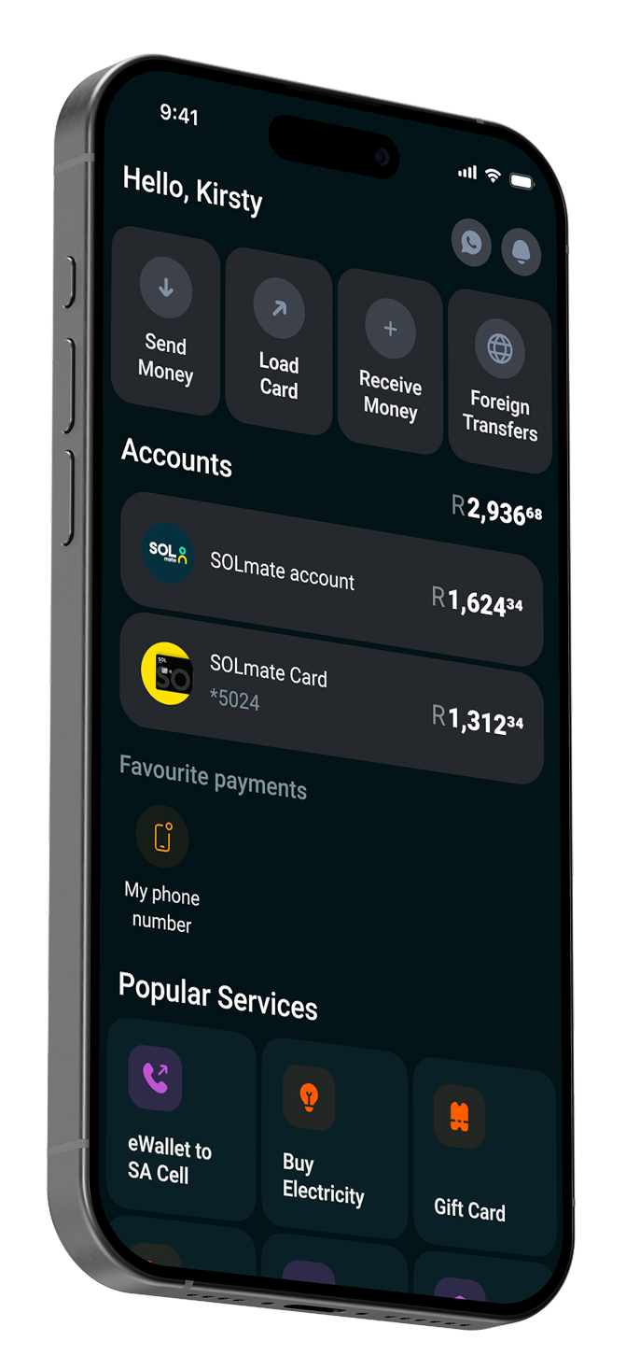
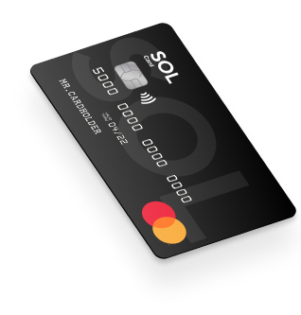




Key Features
5/14
Low-cost digital transactions
Debit card
All types of payment options within South African borders are available
(EFT, ewallets, RTC, cash deposit and withdrawals, online payments)
& full pack
of Prepaid products
(Airtime, Electricity, Water, DSTV, Netflix, Uber etc)
Secure, user-friendly mobile app
International Money Transfers
AML/Anti fraud scoring & filters
Savings tools
& micro-loans
soon

Slide 6
Empower underserved communities to achieve financial inclusion, stability and growth
6/14
Our mission

Slide 7
Market opportunity
7/14
The Problem
The Potential
45% 20+ mln people
In South Africa are considered to be unbanked or underbanked
(source: National Treasury)
High costs and limited access to traditional banking services
Lack of financial literacy tools targeting low-income earners
over 30 million
people need affordable and accessible financial solutions.
Rising smartphone penetration
70%+ as of 2024
Government incentives for financial inclusion initiatives

Slide 8
Financial services for Low-income communities
8/14
Current Landscape:
Limited offerings
from traditional banks for low-income communities
Predatory lending practices targeting low-income earners
High demand for micro-loans and savings tools
Challenges:
Mistrust in financial institutions
High transaction fees
Limited access to physical bank branches in rural areas
Low computer literacy and communication challenges
Opportunities:
Growing fintech adoption among low-income users
Favorable regulatory environment for digital financial services

Slide 9

Why SOLmate will succeed

Slide 10
Unique Value Proposition:
10/14
◉ Affordable and transparent pricing
Cutting-edge technology to aggregate the most used products for better experience and less friction
◉
Simplified products and onboarding processes for low-income customer challenges
◉
Lifestyle services embedded into the same app provide better experience
and less friction
◉
Mobile-first platform accessible
anytime, anywhere
◉
Focus on financial literacy and AI based education empowered via the preferred channels (chat and Whatsapp)
◉

Slide 11
Competitive Advantage:
11/14
◉
Tailored solutions
for South Africa’s unique challenges with highest variety of payment solutions
◉
Partnerships with local infrastructure
payment providers and regulatory bodies, TPPP and FSP licensing, BIN sponsorship
◉
Strong overseas
R&D team
which leads to the best mobile and API tech solution and AI LLM integrations
Sales Proposal

Slide 12

Social Impact:
12/14
◉
Boosts financial inclusion
◉
Encourages economic growth in underserved
communities
◉
Aligns with global
and local SDGs
(Sustainable Development Goals)
Sales Proposal

